Slide 1

BIRLA VISHWAKARMA MAHAVIDYALAYA
Data Transfer and Rotate Instructions
Subject : Microprocessor and Interfacing
Guided By : S. A. Bakhru
Prepared By :
Anjali Gohel (130070107023)
Khushbu Mistry (130070107028)
Priti Mistry (130070107032)

Slide 2
What is instruction?
An instruction is a binary pattern designed inside a microprocessor to perform a specific function.
The entire group of instructions, called instruction set, determines what functions the microprocessor can perform.
8085 has 246 instructions.
Each instruction is represented by an 8-bit binary value.

Slide 3
Classification of instruction Set
There are 5 Types,
(1) Data Transfer Instruction,
(2) Arithmetic Instructions,
(3) Logical Instructions,
(4) Branching Instructions,
(5) Control Instructions,

Slide 4
Data Transfer Instruction
These instructions move data between registers, or between memory and register.
These instruction copy data from source to destination.
While coping, the contents of source are not modified.

Slide 5
Data Transfer Instructions
Opcode | Operand | Bytes | M-cycles | T-states | Types of M-cycle | Flags affected | Addressing mode
MOV | Rd, Rs | 1 | 1 | 4 | F | No flags are affected | Register direct
MOV | M,Rs Rd, M |  | 2 | 7 | F,R | No flags are affected | Register indirect Register direct
MVI | Reg., data | 2 | 2 | 7 | F,R | No flags are affected | Immediate
MVI | Mem., data | 2 | 3 | 10 |  | No flags are affected | Register indirect

Slide 6
Opcode | Operand | Bytes | M-cycles | T-states | Types of M-cycle | Flags affected | Addressing mode
LXI | REG. pair, 16-bit data | 3 | 3 | 10 |  | No flags are affected | Immediate
LDA | 16 bit address | 1 | 2 | 7 | F,R | No flags are affected | Direct
STA | 16 bit | 3 | 4 | 13 |  | No flags are affected | direct
LDAX | B/D reg. pair | 1 | 2 | 7 | F,R | No flags are affected | Register indirect
STAX | B/D reg. pair | 1 | 2 | 7 | F,R | No flags are affected | Register indirect

Slide 7
Opcode | Operand | Bytes | M-cycles | T-states | Types of M-cycle | Flags affected | Addressing mode
LHLD | 16 bit address | 3 | 5 | 16 |  | No flags are affected | Direct
SHLD | 16 bit address | 3 | 5 | 16 |  | No flags are affected | Direct
XCHG | none | 1 | 1 | 4 | F | No flags are affected | Register direct

Slide 8
Rotate Instructions
INSTRUCTION | Operand | Bytes | M-Cycles | T-states | Hex code | Types of M-Cycles | Flags Affected | Addressing Mode
RLC | None | 1 | 1 | 4 | 1F | F | CY (D7) | Implied
RRC | None | 1 | 1 | 4 | 0F | F | CY(D0) | Implied
RAL | None | 1 | 1 | 4 | 17 | F | CY (D7) | Implied
RAR | None | 1 | 1 | 4 | 1F | F | CY(D0) | Implied

Slide 9
RLC : Rotate accumulator left
Each binary bit of the accumulator is rotated left by one position.
Bit D7 is placed in the position of D0 as well as in the Carry flag.
CY is modified according to bit D7.
S, AC, Z, P are not affected.
Example
Instruction: RLC Hex code:07

Slide 10
Before Execution
CY
B7 | B6 | B5 | B4 | B3 | B2 | B1 | B0
After Execution
B7
B6 | B5 | B4 | B3 | B2 | B1 | B0 | B7

Slide 11
RAL : Rotate accumulator left through carry
Each binary bit of the accumulator is rotated left by one position through the Carry flag.
Bit D7 is placed in the Carry flag, and the Carry flag is placed in the least significant position D0.
CY is modified according to bit D7. S, AC, Z, P are not affected.
Example:
Instruction: RAL Hex code:17

Slide 12
Before Execution
CY
B7 | B6 | B5 | B4 | B3 | B2 | B1 | B0
After execution
B7
B6 | B5 | B4 | B3 | B2 | B1 | B0 | CY

Slide 13
RRC : Rotate Accumulator Right
Each binary bit of the accumulator is rotated right by one position.
Bit D0 is placed in the position of D7 as well as in the Carry flag.
CY is modified according to bit D0.
S, AC, Z, P are not affected.
Example:
Instruction: RLC Hex code:0F

Slide 14
Before Execution
B7 | B6 | B5 | B4 | B3 | B2 | B1 | B0
CY
After Execution
B0
B0 | B7 | B6 | B5 | B4 | B3 | B2 | B1

Slide 15
RAR : Rotate Accumulator right through Carry
Each binary bit of the accumulator is rotated right by one position through the Carry flag.
Bit D0 is placed in the Carry flag, and the Carry flag is placed in the most significant position D7.
CY is modified according to bit D0.
S, AC, Z, P are not affected.
Example:
Instruction: RAR Hex code:1F

Slide 16
Before Execution
CY
B7 | B6 | B5 | B4 | B3 | B2 | B1 | B0
After Execution
CY
B7 | B6 | B5 | B4 | B3 | B2 | B1 | B0

Slide 17
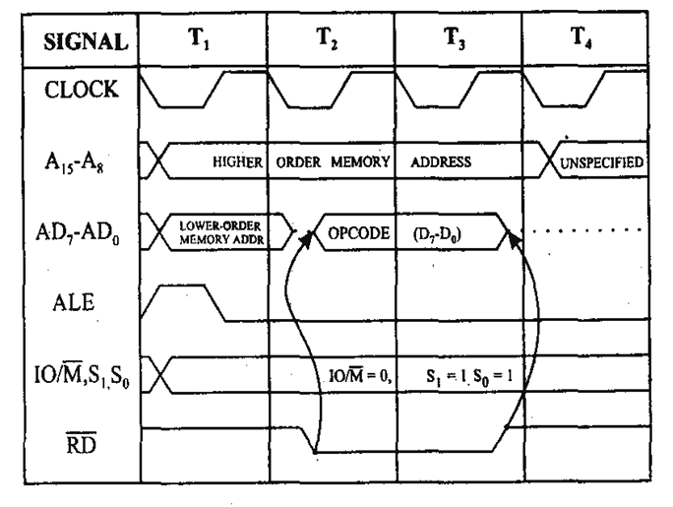
Fetch Machine Cycle

Slide 18
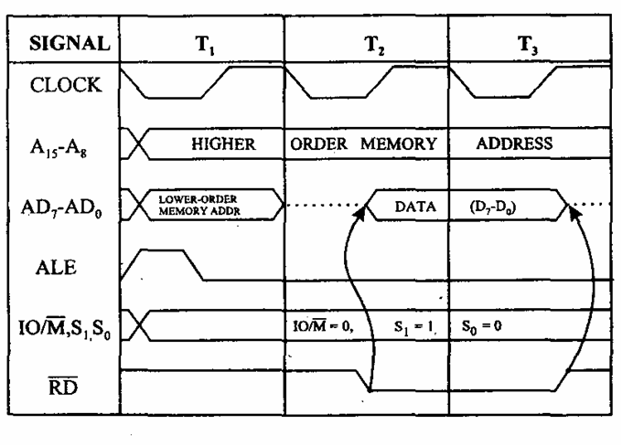
Read Machine Cycle

Slide 19
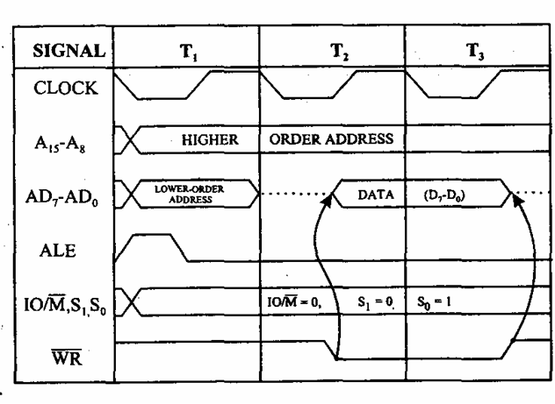
Write Machine Cycle

Slide 20
Timing Diagram for STA 526AH Instruction

Slide 21
